Slide 1

"Do good again and again, and take delight in it.
Blissful is the accumulation of good"
The Helping Hands Global Educational Center
Hunt County, TX
www.hhidm.org

Slide 2
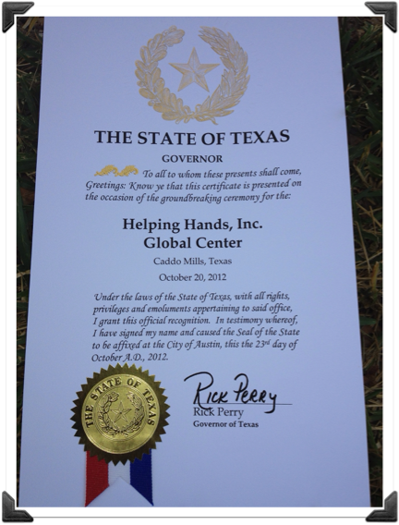
Recognition Letter From Texas State Governor Rick Perry
Recognition Letter From Texas State Governor Rick Perry

Slide 3
The Mission of Helping Hands Inc.
Provide food, clothing, education, shelter, and healthcare to homeless, orphaned street children around the world in a loving, supportive environment.
Promote to all children an awareness of every culture represented by 200 countries at the Global Center via free classes, internships, events, and various interactive learning.
This is a one-of-a-kind platform joining local community leaders to the Global Center, to their UN Ambassador and to our HHI chapter in their native country.

Slide 4
WHAT THE "GLOBAL CENTER" WILL OFFER
TO ALL CHILDREN
Provide a recreational educational environment that teaches diversity and an understanding of all cultures.
Offer education on major cultural health traditions from around the world.
Teach sustainable organic gardening while promoting harmony of mind and body and respect for our natural resources.
Opportunities to learn and intern at our state of the art film studio with seasoned professionals in the film industry.
Free classes such as globally diversified fine arts, history, art, health, and sports.
The ability to grow in a balanced, peaceful, nurturing, diversified environment surrounded by global cultures.

Slide 5






ORGANIZATIONAL FLOW CHART
HELPING HANDS INC.
Non-Profit
Entity
DAWN HOLDING LLC.
Profit Entity
Contracts
DAWN HOLDING LLC.
Profit Entity
HHI Global
Educational
Cultural
Center
Manages
HHI Global
Educational
Cultural
Center
Profits for
Dawn Holdings LLC
Helping Hands Inc.
Non-Profit
Global Outreach
Generates
Funds

Slide 6
Phase One of The HHI Global Center
The International Center - 200 (500 sq.ft) buildings, dedicated to represent each nation at the Global Center.
A state-of-the-art film studio with 125 acres dedicated to movie making.
Premier 18-hole golf course
A 150 acre lake with boats and full amenities
A 5-Star Hotel

Slide 7
Phases 2-5 of The HHI Global Center
An International Artisan Village
5-Star hotel #2
World Organic Garden
Hostel to accommodate 200 students
International Food Village (native cafés)
Outdoor 2,000 seat Amphitheater
Center for Natural Alternative Health
Administration Building and Classrooms

Slide 8
Valuing the Wisdom of
Our Elders
We believe that there is untapped knowledge and wisdom in the minds and memories of our senior citizens.
We plan to engage our elders in a special program at The Global Center.
Opportunity to share real world cultural history and native customs with the children to add their unique and valuable wisdom and teachings.

Slide 9
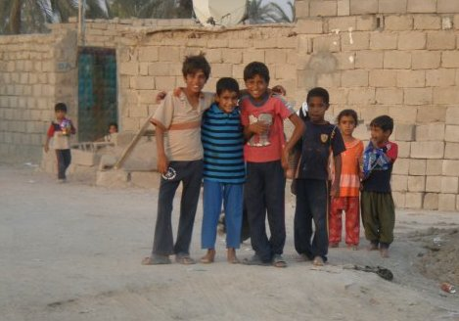
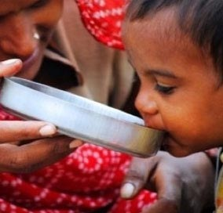
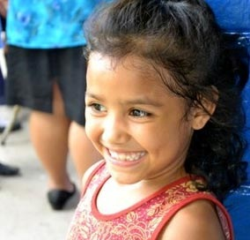

REQUIREMENTS FOR BECOMING AN HHI GLOBAL REPRESENTATIVE
18 + years of age
Ethnic background of the country you represent
Actively involved in the local community of the country you represent
Participate in HHI Brick Program
Act as liaison between your local community, HHI Global Center, HHI chapter in your native country and UN Ambassador of your native country.
Coordinate and procure the needed materials within your 500 sq. ft. building with cultural, historical displays, paintings, literature about your country, natural resources, items to export, vendor information, etc.
Contd.

Slide 10
REQUIREMENTS FOR BECOMING AN HHI GLOBAL REPRESENTATIVE
Provide travel information, educational programs for foreign students.
Coordinate with other nations at the Global Center for events representing your country at global events
Promote International Food and Artisan Villages to your local ethnic community
Keep current with local community, native country HHI Global Center. Maintain a current bulletin board regarding information about your country
Submit a monthly report to HHI administration

Slide 11
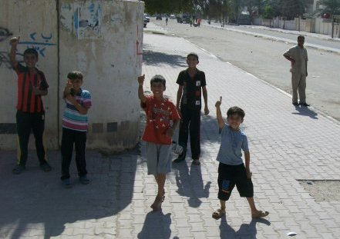
BENEFITS OF BECOMING A HELPING HANDS INC. GLOBAL REPRESENTATIVE
Your own office within your native country's designated 500 sq. ft. building at The International Center.
Enable the growth and sustained development of communications between your nation and other nations around the world represented at the Global Center.
Be an asset to your country by acting as a liaison between your local community, the satellite HHI chapter in your home country and your countries' ambassador at the United Nations.
Contd.

Slide 12
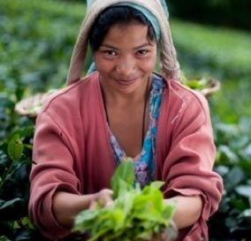
BENEFITS OF BECOMING A HELPING HANDS INC. GLOBAL REPRESENTATIVE
Enjoy products from acres of organic gardens located at the Global Center
Access to the International Film Studio and the independent film maker community with the guidance of a Hollywood professional.
Access to the native medicines of your ancestors, as well as an introduction to remedies from all over the globe.
Contd.

Slide 13
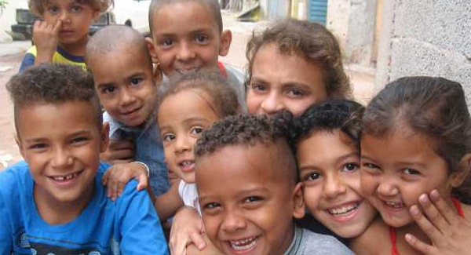
BENEFITS OF BECOMING A HELPING HANDS INC. GLOBAL REPRESENTATIVE
VIP access for you and your guests to ongoing cultural events use of the many amenities available on site.
Each nation, will have their own Celebration Day each year to promote their heritage by showcasing events at the Global Center.
The opportunity to enjoy a nature preserve taking advantage of luxury in a peaceful, serene environment at an eco-friendly setting.

Slide 14
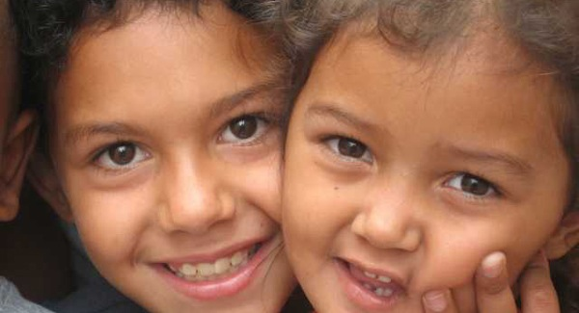
FINANCIAL STRATEGY
We invite EB5 Visa and private investors to our global project through Dawn Holding Company LLC.
Helping Hands Inc. will generate funds through grants, donations and ongoing fundraisers to be self-sustaining.
"BUILD A DREAM ~BRICK BY BRICK" Program...

Slide 15
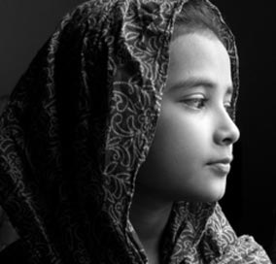
"BUILD-A-DREAM ~BRICK-BY-BRICK" PROGRAM
Leave a lasting legacy by immortalizing your choice of name on your own brick to be used to build the “Wall of Confidence" surrounding the facility.
Named as an outward symbol of the global purpose of HHI:
Build confidence, self-esteem, connectedness and acceptance for all cultures Create a strong, confident, brighter future for all children.
For $100 tax deductible donation any individual, family, company, organization, association or country can be an important part of this humanitarian cause.
As our “Thank You” every donor will receive a:
Charitable Donation receipt
Certificate of Merit
Customized Brick
Choice of one name on our website
Lasting memory that can be shared with generations to come.

Slide 16
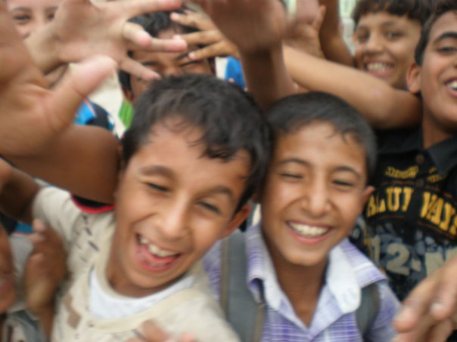
"Thank You
For Your Support
As We Work Together
For All Global Communities"
The Helping Hands Inc. Team

